Slide 1
Previous class notes

Slide 2
Addition of 2 bytes
Carry 1011111
11011011
+ 11001111
110101010
You might well have to add 3 bits together

Slide 3
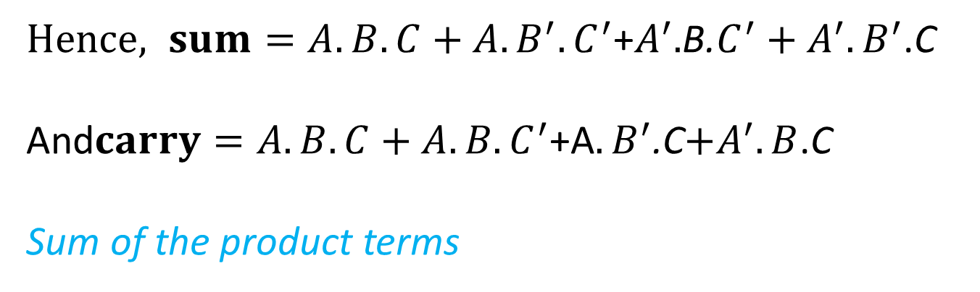
Addition of 3 bits
a | b | c | carry | sum
1 | 1 | 1 | 1 | 1
1 | 1 | 0 | 1 | 0
1 | 0 | 1 | 1 | 0
1 | 0 | 0 | 0 | 1
0 | 1 | 1 | 1 | 0
0 | 1 | 0 | 0 | 1
0 | 0 | 1 | 0 | 1
0 | 0 | 0 | 0 | 0
The sum takes up a value of 1 if
A and B and C are all 1
Or A is 1 and B is 0 and C is 0
Or A is 0 and B is 1 and C is 0
Or A is 0 and B is 0 and C is 1
$Hence, sum=A.B.C+A.B^{′}.C^{′}$+$A^{′}.$B.$C^{′}+A^{′}.B^{′}$.C
And$carry=A.B.C+A.B.C^{′}$+A$.B^{′}$.C$+A^{′}.B$.C
Sum of the product terms

Slide 4
The value of carry
Carry = A.B.C + A.B.C/ + A/.B.C + A.B/.C
= A.B.C + A.B.C/ + A.B.C + A/.B.C + A.B.C + A.B/.C
= A.B.(C+C/) + B.C.(A+A/) + A.C.(B+B/)
= A.B + B.C + A.C

Slide 5
The value of Sum
Sum = A.B.C + A.B/.C/ + A/.B.C/ + A/.B/.C = A . (B.C + B/.C/) + A/. (B.C/ + B/.C)
Now, B.C/ + B/.C = B ⊕ C , and
(B.C + B/.C/)/ = (B.C) / . (B/.C/)/ = ( B/ + C/ ) . ( B + C ) = B.B/ + B.C/ + B/.C + C.C/
= B.C/ + B/.C = (B ⊕ C) /
Hence,
A . (B.C + B/.C/) + A/. (B.C/ + B/.C) = A.(B ⊕ C)/ + A/ . (B ⊕ C) = A ⊕ B ⊕ C

Slide 6
Numerical problem 2.1
There is a grinding machine in which coolant is to be applied automatically if
The temperature ≥ 60° C , surface speed ≥ 20 m/s & table feed ≤ 15 m/min
The temperature ≥ 60° C , surface speed < 20 m/s & table feed > 15 m/min
The temperature ≥ 60° C , surface speed ≥ 20 m/s & table feed > 15 m/min
If sensors are set up in such a way that the following variables
A = 0 when temperature < 60° C
= 1 when temperature ≥ 60° C
B = 0 when surface speed < 20 m/s
= 1 when surface speed ≥ 20 m/s
C = 0 when feed ≤ 15 m/min
= 1 when feed > 15 m/min
Make a circuit which would send an output signal S = 1 when coolant is supposed to be applied, otherwise 0.
Grinding machine
Coolant
A
?
B
S=1/0
C

Slide 7
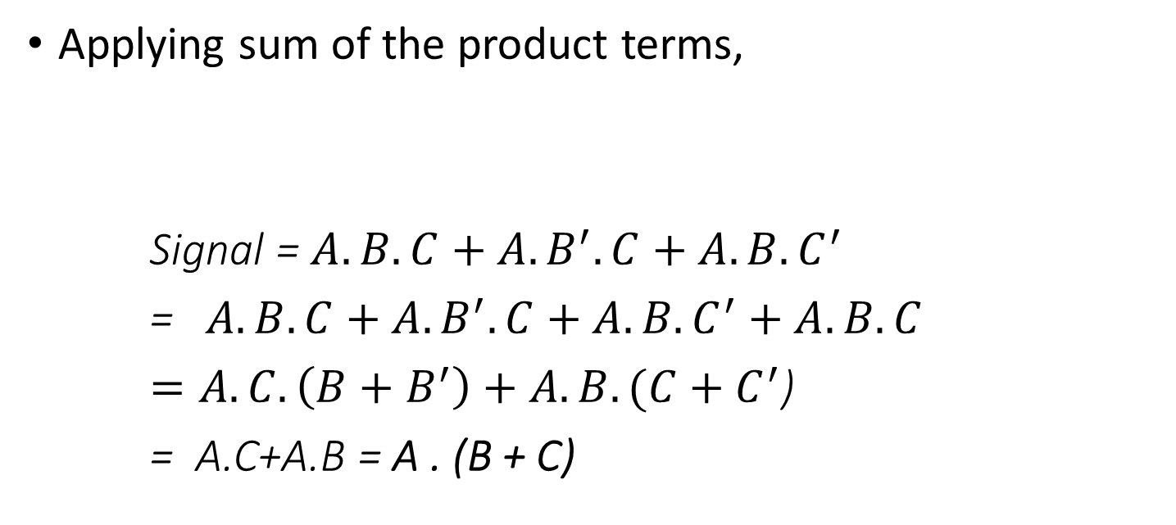
Solution to Prob 2.1
A | B | C | signal
1 | 1 | 1 | 1
1 | 1 | 0 | 1
1 | 0 | 1 | 1
1 | 0 | 0 | 0
0 | 1 | 1 | 1
0 | 1 | 0 | 0
0 | 0 | 1 | 0
0 | 0 | 0 | 0
Applying sum of the product terms,
Signal = $A.B.C+A.B^{′}.C+A.B.C^{′}$
=$A.B.C+A.B^{′}.C+A.B.C^{′}+A.B.C$
$=A.C.\left(B+B^{′}\right)+A.B.(C+C^{′}$)
= A.C+A.B = A . (B + C)

Slide 8
Point-to-point control – one example
Pulse Generator
Position down counter
1 | 1 | 0 | 1 | 0 | 1 | 1
AND
OR Gate
End of count
Lead screw 4 mm pitch, 2 start
CNC Table X →
Motor driver
Stepper Motor, 200 Steps/rev
Gear box Ratio = ¼

Slide 9
Explanations to the control loop elements
PDC = position down counter. It can be loaded with a binary number. A train of pulses input as shown will downcount the content of the counter, 1 bit for 1 pulse.
End of count = All the bits of the PDC are input t the OR gate. The OR gate will output a 0 only when all the inputs are 0. Which means – the contents of the PDC have been counted down to 0, so it is called ‘End of count’.
Pulse generator = The pulse generator sends out pulses continuously at a definite frequency

Slide 10
Explanations – cotd.
Gear Box – Normally, CNC machine tools do not employ gear boxes. However, they may be present as a fixed speed reducer for attaining a definite speed range. Gear ratio = Output RPM/Input RPM
Lead screw – nut mechanism : For 1 rotation of lead screw, the nut rotates by p × n = lead, where p = pitch and n = number of starts of screw
Stepper motor – is a motor which moves in discrete steps in response to voltage pulses as input

Slide 11
P-T-P control – another example
Decodersr
Position down counter
1 | 1 | 0 | 1 | 0 | 1 | 1
Analog voltage source
OR Gate
Decelerator
End of count
CNC Table
DC Motor
Gear box Ratio = ¼
Lead screw pitch = 4mm, 1 start
Fig. 1
Encoder, 200 holes

Slide 12
Observations on the two P-T-P systems
In both the examples – there is no velocity control of the table movements.
The position down counter is present in both as it is associated with position control.
In one case – there is internal feedback while in the other – there is external feedback.

Slide 13
MCQ on P-T-P machines
The basic length unit (BLU) of the following drive is
5 microns b. 50 microns
c. 10 microns d. None of the others
p=4 mm pitch
Table
Stepper Motor, 200 Steps/rev
Gear box Ratio = ¼

Slide 14
When to use open loop
Open loop is employed when the prime mover can reliably move through the extent of motion programmed.
For example – the stepper motor can reliably move through discrete steps and stop exactly at a pre-defined location.
In the previous control loop shown – there is indeed a feedback loop – but it is internal

Slide 15
P-T-P closed loop
The DC motor cannot be relied upon to stop at a definite pre-defined location. Hence, an external check is necessary, together with deceleration applied towards the end of motion and mechanical brakes at the end of motion.
The typical feedback device used in this case is the encoder. The encoder, together with an LED-photoreceptor-pulse emitter circuit, is capable of sending feedback pulses which keep count of the extent of rotation of the lead screw.

Slide 16
1. In a PTP open loop CNC drilling machine, a stepper motor drives the table in X direction. The stepper motor shaft is connected to a gear box with ratio (=output rpm/input rpm) ¼ which is in turn connected to a lead screw of pitch = 4 mm and no. of starts = 2. The stepper motor covers 1 rotation in 200 equal steps and executes 1 step per pulse of pulse generator (100 pulses per minute, ppm) received by motor driver. The pulses output from AND gate, go to motor driver and also to a position down counter (PDC). These incoming pulses decrement the content of PDC (1 pulse comes in, PDC content does down by 1). A. What are the BLU (basic length unit) and velocity of the table along x axis ? Line 1 G00 G90 X20 Y30 Line 2 X25 B. What number in binary will the MCU put into PDC for executing line 2 of program above ?
Position down counter
Pulse Generator, 100 ppm
AND Gate
1 | 1 | 0 | 1 | 0 | 1 | 1
OR Gate
End of count
Lead screw 4 mm pitch, 2 start
CNC Table X →
Motor driver
Stepper Motor, 200 Steps/rev
Gear box Ratio = ¼

Slide 17
Answer to problem
Ans :
BLU = 8 mm/800 = 0.01 mm = 10 microns
Velocity = BLU X PPM = 0.01 X 100 mm/min = 1 mm/min
Number to be put in binary inside PDC = 5/0.01 = 500

Slide 18
Find BLU, velocity and number to be put inside PDC
Decodersr
Position down counter
1 | 1 | 0 | 1 | 0 | 1 | 1
Analog voltage source
OR Gate
Decelerator
End of count
CNC Table
DC Motor, 100 rpm
Gear box Ratio = ¼
Lead screw pitch = 4mm, 1 start
Fig. 1
Encoder, 200 holes

Slide 19
Answer to previous problem
BLU = 4 mm/200 = 0.02 mm = 20 microns
Velocity = 100 rpm X ¼ X 4 = 100 mm/minute
Number in binary to be put inside the PDC = 5 mm/BLU = 5 / 0.02 = 250

Slide 20
1. In a techno-fest for innovative designs – a student demonstrates a surface roughness tester he has developed. The stylus is moved with velocity V by a distance of 4 mm and it collects n number of profile data, one profile data for each step of the stepper motor. Stepper motor moves one step for each pulse and covers one rotation in 200 steps. The frequency of the pulses = f = 20 Hz. Pitch of lead screw = 1 mm.
(a) Find the value of n and V
(b) What is the distance covered by the stylus between two readings ?
V
Pulse freq, f
Nut,
p = 1 mm
Gear box ½
Stepper motor

Slide 21
distance between successive readings = BLU = 1 mm/400 =0.0025 mm = 2.5 microns
Number of readings in 4 mm sampling length = 4 mm/0.0025 = 1600
Velocity = BLU X PPS = 0.0025 X 20 = 0.05 mm/s = 3 mm/min

Slide 22
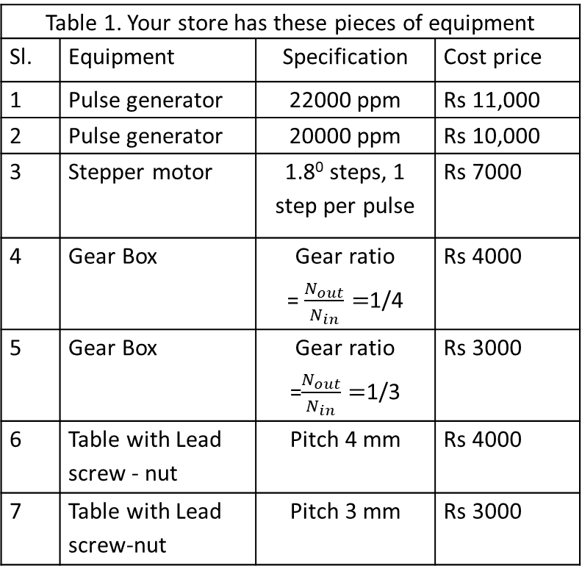
Numerical Problem 3.1
Table 1. Your store has these pieces of equipment
Sl. | Equipment | Specification | Cost price
1 | Pulse generator | 22000 ppm | Rs 11,000
2 | Pulse generator | 20000 ppm | Rs 10,000
3 | Stepper motor | 1.8⁰ steps, 1 step per pulse | Rs 7000
4 | Gear Box | Gear ratio = $\frac{N_{out}}{N_{in}}=$1/4 | Rs 4000
5 | Gear Box | Gear ratio =$\frac{N_{out}}{N_{in}}=$1/3 | Rs 3000
6 | Table with Lead screw - nut | Pitch 4 mm | Rs 4000
7 | Table with Lead screw-nut | Pitch 3 mm | Rs 3000
A company publishes a tender inviting quotations for a CNC PTP control table which moves only in one axis. The Basic length unit (BLU) is to be 5 microns and the axis velocity is to be 100 mm/min.
You represent another company which builds and sells machines by assembling different pieces of equipment (refer table 1).
Check whether you can build a machine to satisfy the above requirements [4] using 1 PG, stepper motor, 1 GB and 1 table.
Verify whether there is any chance that your quoted price (assuming you want to make a profit of only Rs 1000 for the CNC PTP control table) would be lowest, (refer table 2). [4]
 | Quoting company | Quoted price for CNC PTP control table
1 | Lakshmi Brs pvt ltd | Rs 26,500/-
2 | M/c builders Ltd | Rs 25,400/-
3. | CNC & Co. | Rs 24,300/-
4. | Nuts, Bolts & Comps | Rs 32,100/-
5. | Your company | ?

Slide 23
In a CNC machine with continuous control (the one where path velocity is also controlled), the following commands are executed :
N01 G90 G00 X100 Y200 Z 20
N02 G01 X130 Y240 F50
What is the feed velocity of the cutter in the X direction in line N02 ?

Slide 24
Incremental format, Feed Calculation
The feed (mm/min) along X axis corresponding to the program line G91G01X40Y30F100 is
80
b. 100
c. 60
d. None of the others
(G91 – incremental)

Slide 25
A CNC user wants to remove a stepper motor from one axis of his CNC drilling machine table and replace it with a PMDC (Permanent magnet direct current) motor. The Stepper motor (1 rotation in 200 steps, 1 step for 1 pulse) received pulses from a pulse generator @ 5000 ppm and was driving a lead screw-nut pair (lead = 4 mm) directly. The PMDC motor rotates at a constant speed of 100 rpm and after fitting, should produce same BLU and axis speed as before. The user may employ any 1 lead screw-nut pair & 1 gear box & 1 encoder combination from inventory listed below. No equipment other than these is permitted. Encoder, if used, should be mounted on lead screw.
encoders
400 holes
300 holes
200 holes
Lead of Lead screw-nut pairs
4 mm
6 mm
8 mm
Gear boxes with ratio
½
¼
⅓

Slide 26
MCQ 5
A machine will be said to have CNC control if
The dimensions of the work piece are measured by sensors while cutting goes on
The tool motion is guided by drum cams and disc cams
The loading and unloading of the work piece on and off the machine respectively, is made automatic
Control is achieved by employment of alphanumeric data

Slide 27
(c) In Computer controlled machine tools terminology, a machining center is
(i) The origin of the machine coordinate system with respect to which the operator has to make his program
(ii) The center of the cutter which actually goes to the programmed point (when used without radius compensation)
(iii) A computer control machine tool capable of a variety of operations involving rotating cutters
(iv) None of the others

Slide 28
a) In Computer controlled machine tools, tool movements are controlled by :
Cam (ii) Machine Operator
(iii) Fool proof mechanism (iv) None of the others

Slide 29
MCQ 8
Holes are to be drilled on the circumference of a circle with regular angular spacing. If a CNC machine is used, it should essentially
Have one indexing head mounted on the machine table
Have a CNC rotary axis of motion to rotate the table about Z axis (in addition to X, Y and Z axes of motion)
Be a CNC milling machine with contouring control
None of the others

Slide 30
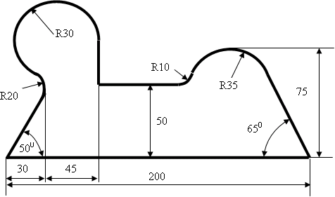
MCQ - 9
The following shape has to be
cut
on a
CNC
milling
machine. The raw material is flat
metal plate, 10 mm thick.
In order to carry out CNC milling, w
e
essentially
require
(a)
A 3
-
axis CNC milling machine with a copy
-
milling attachment
(b)
A
3
-
axis CNC millin
g machine with a ball
-
end milling cutter
(c)
A 5
-
axis CNC machine
with a copy
-
milling
attachment
(d)
A 5
-
axis CNC machine
with
a
ball
-
end milling cutter
(e)
None of the above

Slide 31
For milling a bi-laterally symmetrical 2-D profile on metal plate 10 mm thick, a CNC milling machine would require the following accessory / attachment
Copy milling attachment
Dividing head
Reversing table
Rotary table
None of the above

Slide 32
In order to produce a circular groove by milling in CNC machining centre
A Universal Dividing head is necessary
A planetary gear mechanism actuates table movement
A Rotary table is necessary
None of the above

Slide 33
CNC is not applicable in
Drilling machine
Milling machine
Lathe
All of the above
None of the above

Slide 34
A CNC machine tool has the following advantage over conventionally controlled machine tools
Surface finish of machined part is higher
Cutting forces are less
Cutting temperature is lower
All of the above
None of the above

Slide 35
The incremental encoder is capable of sensing
Direction of movement of the table
Direction of rotation of the lead screw
Direction of rotation of the motor
None of the others

Slide 36
In a PTP machine feed axis employing a stepper motor as prime mover
An encoder for position feedback is a must
An interpolator is a must
A tachogenerator is a must
None of the others

Slide 37
A ⊕ B is equal to
A.B + A’. B’
A’.B + A.B
A’.B + B’. A
None of the others

Slide 38
CNC machines find the widest application in the field of
Mass production
Small lot and batch production
Non-conventional machining
None of the above

Slide 39
CNC machining has the following main advantage over conventional machining practice
Ability to employ higher cutting speeds, feeds and depths of cut
Flexibility
Feedback control
None of the others

Slide 40
9. On the CNC lathe
2-D programming is sufficient
3-D programming is necessary
1-D programming is sufficient
None of the above

Slide 41
10. Interpolator is present in case of
PTP (Point to point) open loop system
PTP (Point to point) closed loop system
Continuous control system
None of the others

Slide 42
In a CNC turning center, threads of different pitches are cut by
Different settings of the Meander drive and Norton-tumbler gears
Different settings of the feed gear box
Different setting of the speed gear box
None of the others

Slide 43
5. A point-to-point (PTP) control CNC machine
a. Does not have an interpolator
b. Does not have a position down counter
c. Never has DC motor as prime mover along any feed axis
d. None of the others

Slide 44
2. In a CNC milling machine, a circular cut is always produced a. by operator's skill and experience b. by copy milling from a master circular shape c. By combined motion of feed axes d. None of the others

Slide 46
In case of a CNC drilling machine, whenever there is table motion, the speed of X-Y table along X axis
Is always same
Can be different for different lines of program
Is always 0
None of the others

Slide 47
CNC machines have the ability to cut complex profiles as
They are equipped with tracer control
The accuracy of the axes movements is very high
They are equipped with high performance gear boxes
None of the above

Slide 48
PTP (Point to point) control of CNC machines is not applicable in case of
Drilling of holes at the vertices of a triangle
Drilling of 73 holes at regular angular intervals on the circumference of a circle
Drilling of holes at intervals of 3 cm on any straight line on XY plane
None of the others

Slide 49
In a CNC machine, complex profiles are cut with the help of
Synchromesh gear boxes in every feed axes of machine
A combination of axes velocities which are infinitely variable
Cam control
None of the others

Slide 50
An innovative student develops a tachometer (instrument which can measure rotational speeds of rotating shafts) by employing simple digital devices. The figure shows a motor shaft connected to the input shaft of the tachometer. When the motor rotates, it makes the input shaft rotate at the same speed. The input shaft has an encoder mounted on it with 64 holes. The 8-bit position down counters are down-counted by the pulses they receive, each pulse making 1 decrement. After connecting the input shaft to the rotating shaft of the motor (whose rpm is to be measured), the two PDCs are filled completely and instrument is started. If PDC1 = 0 and PDC2 = 204, whats the rpm of the motor?
OR
P | D | C | 1
rMotor
INPUT
OR
Pulse generator 64 pps
P | D | C | 2

Slide 51
The rate at which pulses are coming from the motor encoder = 64*N (Where N = rps)
Time required to empty PDC1 = 255/(64*N)
Time required to reduce PDC2 to 204 = 51/64
255/(64*N)=51/64

Slide 52
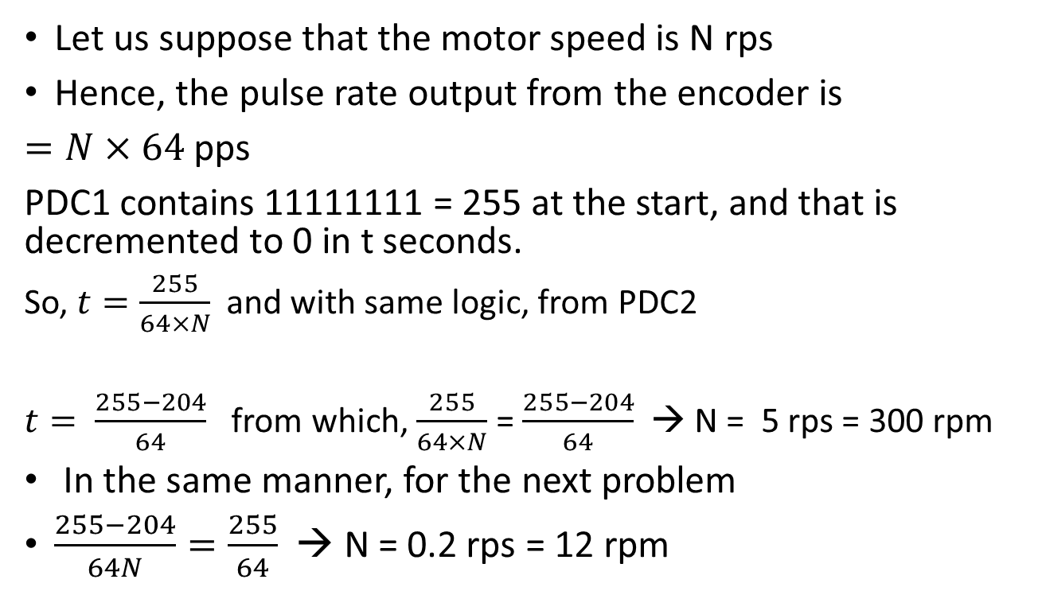
How much is the speed of the motor shaft if instrument shows unchanging values of PDC1 = 0 and PDC2 = 204 after some time. How much is the speed of the motor shaft if instrument shows unchanging values of PDC1 = 204 and PDC2 = 0 after some time.
Let us suppose that the motor speed is N rps
Hence, the pulse rate output from the encoder is
$=N×64$pps
PDC1 contains 11111111 = 255 at the start, and that is decremented to 0 in t seconds.
So, $t=\frac{255}{64×N}$ and with same logic, from PDC2
$t= \frac{255−204}{64}$ from which, $\frac{255}{64×N}$ = $\frac{255−204}{64}$→ N = 5 rps = 300 rpm
In the same manner, for the next problem
$\frac{255−204}{64N}=\frac{255}{64}$→ N = 0.2 rps= 12 rpm

Slide 53
One problem on decoder
In a workshop – an alarm system is incorporated such that the maintenance section is informed the moment any one or more of six machines are down. If a machine is up it emits 1 otherwise 0. The maintenance section wants a 1 as an alarm. In that case – what should be the circuit which will make this possible.

Slide 54
A Decoding circuit is to be designed which detects whether the CNC table is 5 BLU or less away from the target location. If so, it sends out a signal d = 1 to the pulse generator. Design this decoding circuit A.
Part of the required circuit is already provided. Unless the 4 most significant bits are zeros, the OR gate OR1 wont send out a 0. Now if the decoding circuit is to work , it should send out a 1 for 101, 100, 011, 010, 001 and 000. Contd. In next page….
d
Decoding circuit A
OR1
Pulse Generator, 100 ppm
AND Gate
0 | 0 | 0 | 0 | a | b | c
Position down counter
OR Gate OR2
End of count
Lead screw 4 mm pitch, 2 start
CNC Table X →
Motor driver
Stepper Motor, 200 Steps/rev
Gear box Ratio = ¼

Slide 55
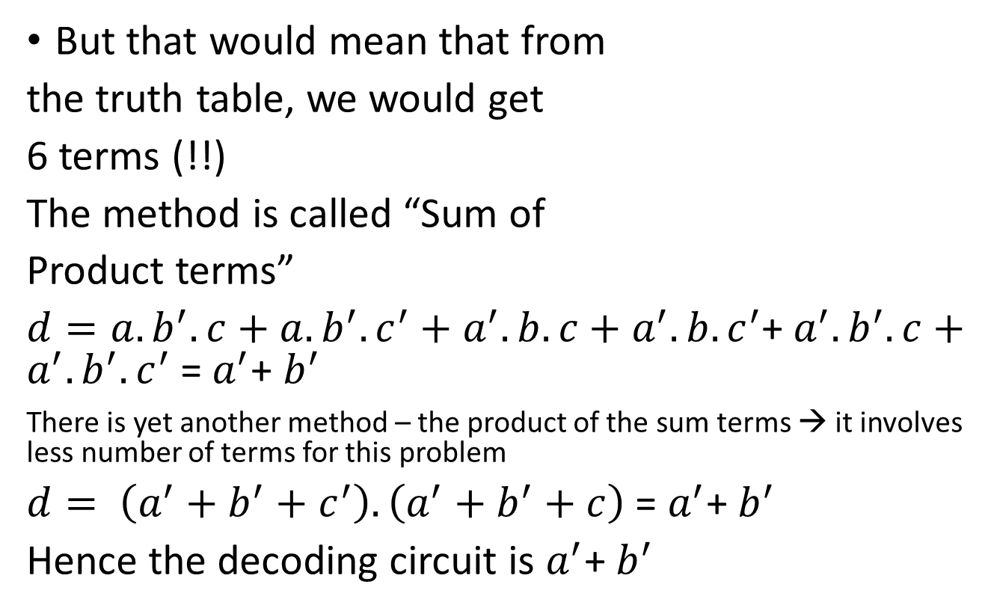
Decoding circuit problem contd…
a | b | c | d
1 | 1 | 1 | 0
1 | 1 | 0 | 0
1 | 0 | 1 | 1
1 | 0 | 0 | 1
0 | 1 | 1 | 1
0 | 1 | 0 | 1
0 | 0 | 1 | 1
0 | 0 | 0 | 1
But that would mean that from
the truth table, we would get
6 terms (!!)
The method is called “Sum of
Product terms”
$d=a.b^{′}.c+a.b^{′}.c^{′}+a^{′}.b.c+a^{′}.{b.c}^{′}$+${ a}^{′}.b^{′}.c+a^{′}.{b^{′}.c}^{′}$= $a^{′}$+ $b^{′}$
There is yet another method – the product of the sum terms → it involves less number of terms for this problem
$d= \left(a^{′}+b^{′}+c^{′}\right).\left(a^{′}+b^{′}+c\right)$ = $a^{′}$+ $b^{′}$
Hence the decoding circuit is $a^{′}$+ $b^{′}$

Slide 56
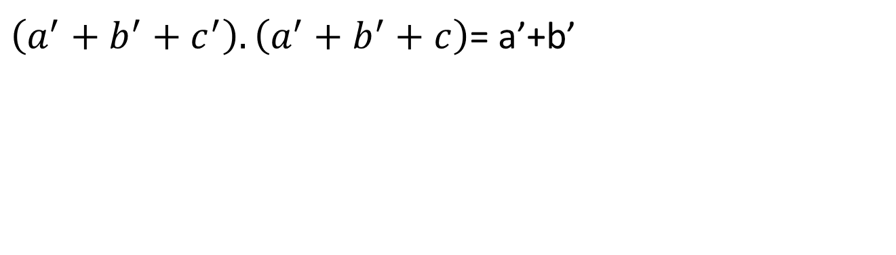
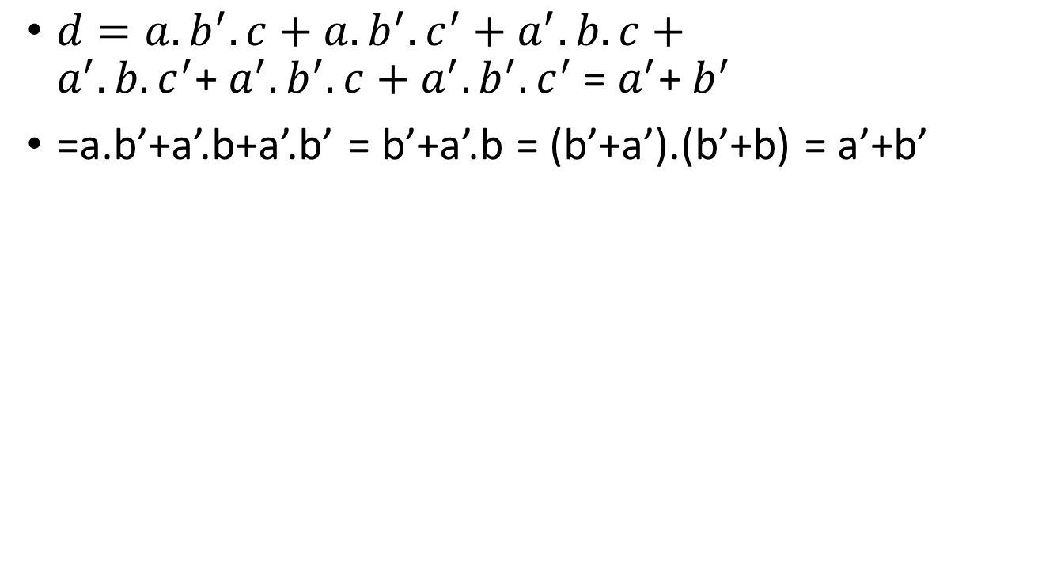
a+a.b = a.1+a.b = a.(1+b) = a
$d=a.b^{′}.c+a.b^{′}.c^{′}+a^{′}.b.c+a^{′}.{b.c}^{′}$+${ a}^{′}.b^{′}.c+a^{′}.{b^{′}.c}^{′}$= $a^{′}$+ $b^{′}$
=a.b’+a’.b+a’.b’ = b’+a’.b = (b’+a’).(b’+b) = a’+b’
$\left(a^{′}+b^{′}+c^{′}\right).\left(a^{′}+b^{′}+c\right)$= a’+b’

Slide 57
CNC programming : Computer numerical control programming 10th lecture
When a computer program, on being executed, successfully guides a machine tool through the sequence of motions and actions necessary for machining a part, or simulates such motions and actions on a graphic user interface, it is an example of computer numerical control programming or simply CNC programming.

Slide 58
G & M code programming
G & M Code programming language is a coded language to intimate to the machine
The type of motion to be executed
The auxiliary operations to undertake
through codes essentially preceded by G (preparatory function) or M (Miscellaneous function). Apart from such codes, parametric functions ( E parametres) and three letter codes are also admissible.
The G codes prepare the machine controls for the type of machine movements which are going to take place.
M codes provide instructions to the machine about the auxiliary or non-cutting operations (like tool change, spindle start, coolant on etc.). They are sometimes referred to as managerial or auxiliary commands.

Slide 59
Types of programmed motions
There are 4 basic types of motion for CNC machines.
The rapid traverse motion
the linear motion (at controlled feedrate)
the circular clockwise motion (at controlled feedrate)
the circular counterclockwise motion (at controlled feedrate)

Slide 60
Description of the basic G codes for motion
Code | Explanation | Format
G 00 | Rapid traverse | G00 X 200 Y300 Z 400
G 01 | Linear motion at controlled feed | G01 X 220 Y 320 Z440 F 200
G 02 | Circular clockwise motion | G02 X 250 Y 350 R 150 F200 or G02 X 250 Y 350 CX 270 CY 370 F200
G 03 | Circular counter clockwise motion | G03 X 300 Y 370 R 130 F 200 or G02 X 250 Y 350 CX 270 CY 370 F200

Slide 61
Example of typical command blocks
N006 G90 G00 X20 Y30
N007 Y50
N008 G01 X100 Y100 F200
N009 G02 X140 R200
N010 M30
Y
(100,100)
(140,100)
(20,50)
(20,30)
X

Slide 62
Program – starting declarations
Program may start with a number of declarations
Whether we want an incremental or absolute system of reference
Whether a number of options, if previously activated, are to be cancelled
Whether there is a declaration on the type of coordinate system or offset from such a coordinate system
Whether there is any declaration on tool / cutter and its length and diameter offsets
N001 G90 G40 G49 G80 G53 X0 Y0 ZO;
N002 M6 T12;
N003 G0 G90 G56 X-10 Y-10;
N004 M3 S2000;
N005 G43 H12 Z50;

Slide 63
Program structure – main program
The main body of the program may contain the various movements required
Alternatively – it may contain calls to subroutines which in their turn – contain various motion commands
A typical program may have a structure as follows

Slide 64
Mirror Imaging
Linear interpolation
Circular interpolation
Tool length offset
Tool diameter offset
Subroutine call
Canned drilling cycle
Repeat loop
Cutter diameter compensation
Cycle cancellation

Slide 65
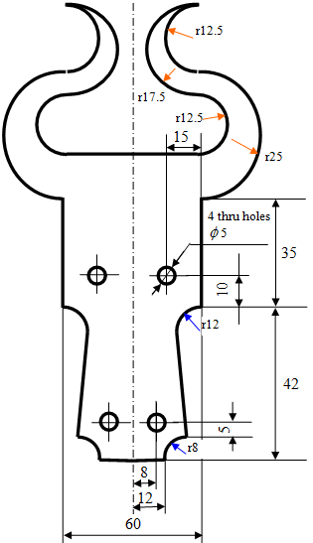
Example programs
Mirror Imaging
Linear interpolation
Circular interpolation
Tool length offset
Tool diameter offset
Subroutine call
Canned drilling cycle
Repeat loop
Cutter compensation
Cycle cancellation

Slide 66
Program
Milling subroutine
N02 M03 S1200 F500;
N03 G42 D03 G00 X0 Y0;
N04 Z -2.0;
N05 G01 X12 Y0;
N06 G02 X20 Y8 R8;
N07 G01 X18 Y30;
N08 G02 X30 Y42 R12;
N09 G01 X30 Y77;
N10 G03 X30 Y127 R25;
N11 G02 X30 Y152 R12.5;
N12 G03 X30 Y117 R17.5;
N13 G02 X30 Y92 R12.5;
N14 G01 X0 Y92;
N15 G01 Z30;
N16 G40 Y-12;
N17 M05;
N18 M99;
Drilling Subroutine: (P0038)
N50 G90 G40 G49 G80 G53 X0 Y0 Z0;
N51 M06 T04;
N52 M03 S1500;
N53 G56 G0 G90 X0 Y0;
N54 G43 H04 Z20;
N55 G81 G99 X8 Y13 Z-3.5 R15 F100;
N56 X-8 Y13;
N57 X-15 Y52;
N58 X15 Y52;
N59 G0 Z30;
N60 G0 X0 Y0;
N61 M05;
N62 M99;
Main Programme: (P0036)
N100 G90 G0 G40 G49 G80 G53 X0 Y0 Z0;
N101 T12 M6;
N102 G90 G56 G17 X0 Y-10;
N103 G43 H12 Z50;
N104 M98 P0037;
N105 G51.1 X0;
N106 M98 P0037;
N107 G0 Z30;
N108 G50.1 X0;
N109 M98 P0038;
N110 M05;
N111 M02;
N112 M30;

Slide 67
Display Z = Z1+Z2+Z3
Spindle
Z1
This
gap is Z3
Z2 is the job height

Slide 68
Program start
Call Milling
Mirror imaging
Call Milling
Cancel Mirror
Call drilling
Milling subroutine
Drilling subroutine

Slide 69
G00 – Rapid traverse
G01 – Linear
G02 – Circular CW
G03 – Circular CCW
G20 – Cancel GTL
G21 – Enable GTL
G40 – Cancel cutter radius compensation
G41 – Cutter radius compensation left
G42 – Cutter radius compensation right
G81 – Canned drilling cycle
G90 – absolute programming
G91 – Incremental programming
M00 – program pause
M03 – Spindle on
M05 – Spindle off
M06 – Tool change
M08 – Coolant on
M09 – Coolant off
CLS – call subroutine
RPT – Repeat
URT – rotate coordinate system
UOT – use temporary origin
UAO – Use absolute origin
ERP – End of Repeat

Slide 70
Programming practice - II
11th Lecture in the open online course “Computer Numerical Control (CNC) of Machine Tools and Processes

Slide 71
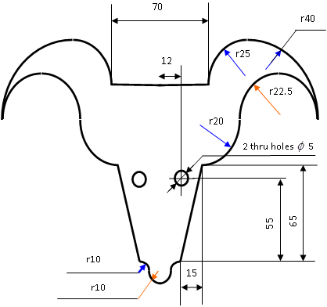
Example programs
Mirror Imaging
Linear interpolation
Circular interpolation
Tool length offset
Tool diameter offset
Subroutine call
Canned drilling cycle
Cutter compensation
Cycle cancellation

Slide 72
Program structure
Program start
Call Milling
Mirror imaging
Call Milling
Cancel Mirror
Call drilling
Milling subroutine
Drilling subroutine

Slide 73
Job for Machining Centre

